Slide 2
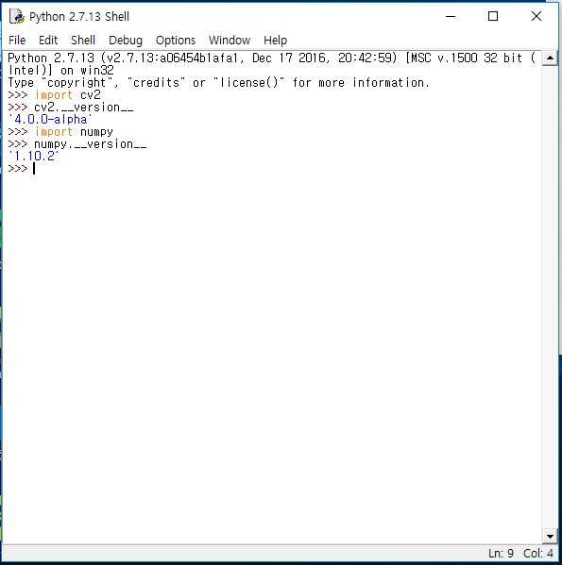
Windows 에서opencv 설치
참고자료:
https://docs.opencv.org/4.0.0-beta/d5/de5/tutorial_py_setup_in_windows.html
(Installing OpenCV from prebuilt binaries 부분 참고)

